Slide 1

A better life at
Solihull Village
Sales Information | September 2026 Edition 1

Slide 2

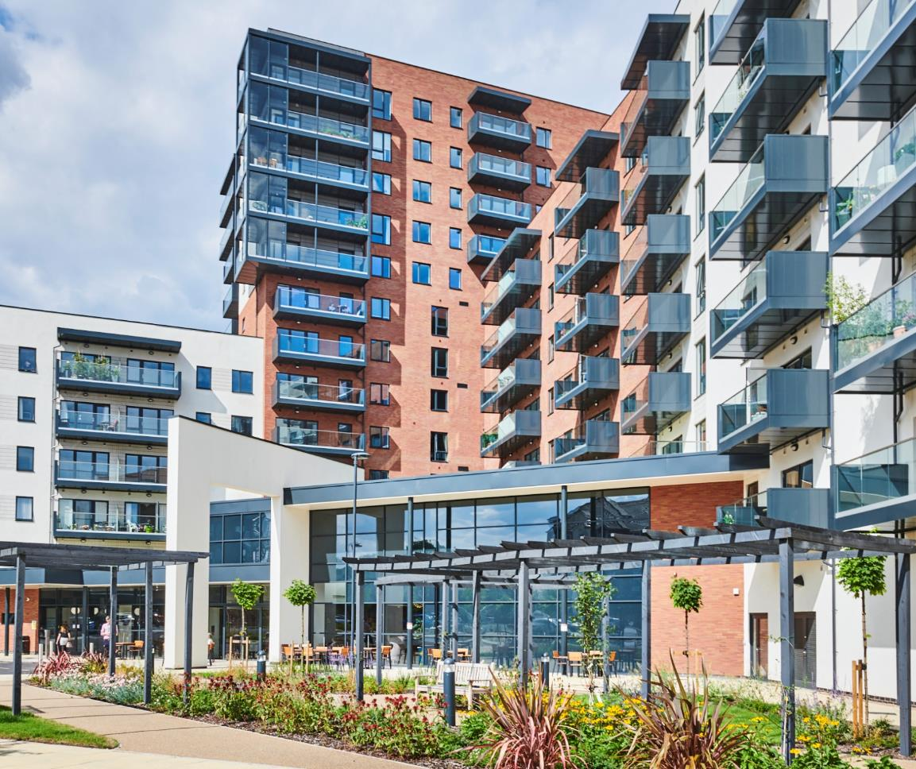
Our Charity
The ExtraCare Charitable Trust is a charity established in 1988 and supports over 4,300 older people in 18 locations across the country.
Our vision is to build better lives for older people and our mission is to create sustainable communities that provide homes older people want, lifestyles they can enjoy and care if it’s needed.
Any surplus funds that we generate are used by the Charity to support residents' housing, health and wellbeing, and to develop new communities.
Sales Information | September 2026 Edition 1
2

Slide 3

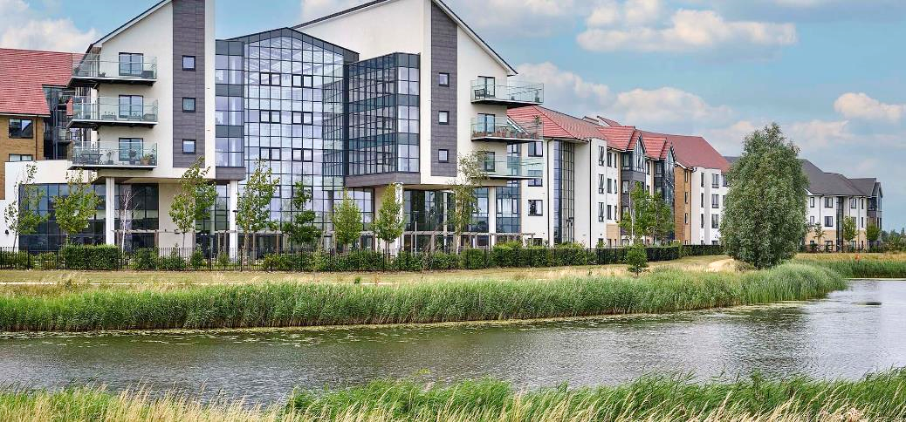
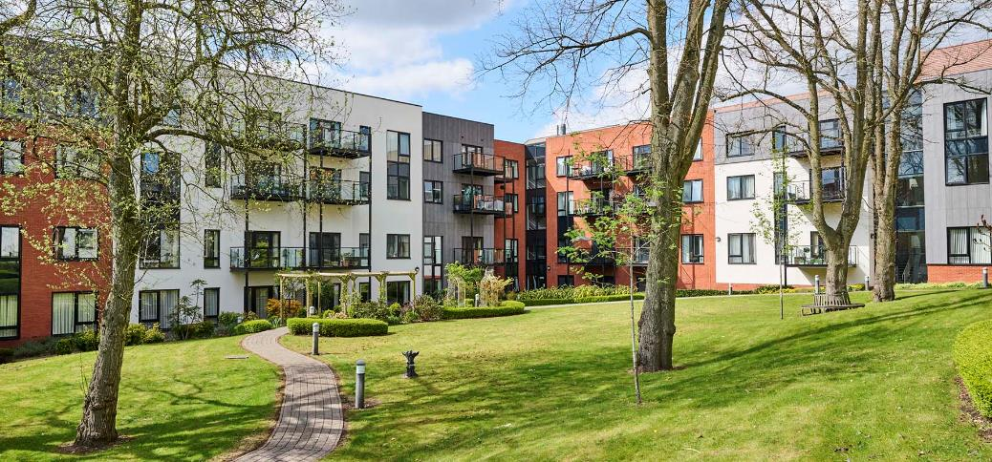
Solihull Village
A vibrant integrated retirement community (IRC) which is home to a wealth of on-site communal facilities. Our community is diverse, with people from different backgrounds and with differing needs for care (most residents require no care).
Solihull Village opened in September 2021 and has 261 individual homes:
197 properties for shared and outright ownership (72 one bed and 125 two bed apartments)
64 are available for social rent
Some of our facilities are open to people from the wider community, which ExtraCare positively encourages.
Sales Information | September 2026 Edition 1
3

Slide 4

















Communal Facilities
Our communities have a wealth of on-site communal facilities including:
Bistro/restaurant
Bowling Green
Communal Parking
Dementia & Mental Wellbeing Suite
Greenhouse
Guest Suite
Hairdressers
Hobby Room
Launderette
Library/IT Suite
Licensed Bar
Multi-function Games Room
Beauty Salon
Village Hall
Gym
Woodwork Room
4

Slide 5



An incredible range of facilities and activities
A typical hairdressers
Residents can enjoy access to the village’s exceptional facilities and activities.
You choose your own pace of life, whether that’s relaxing in the beautiful shared spaces or taking part in the daily activities. Take time out to look after yourself, try something new, develop your hobbies or share the skills you have already through volunteering – the options are endless.
A typical bistro/restaurant
Sales Information | September 2026 Edition 1
5

Slide 6




Activities
Our communities have an extensive range of daily activities to get involved in. Some of the activities available across our village locations include, but are not limited to:
Chair yoga
Tai chi
Dancing
Bowls
Snooker
Table tennis
Arts and crafts
Zumba
Pilates
Choir
Book club
Walking football
Evening entertainment
The activities available may change over time. There may be a nominal charge for some of these activities.
Sales Information | September 2026 Edition 1
6

Slide 7

Wellbeing Service
An award-winning service which is run by a qualified advisor and is available to all residents.
Use wellbeing assessments to empower you to make informed decisions about your health.
Our locations also offer dedicated drop-in sessions, where you can come along and get further information or help with your health.
This service is funded through the Village Amenities Charge.
Sales Information | September 2026 Edition 1
7

Slide 8

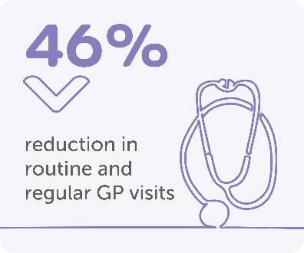
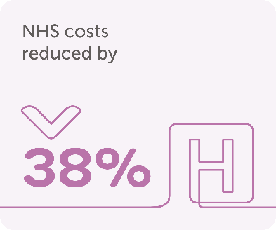
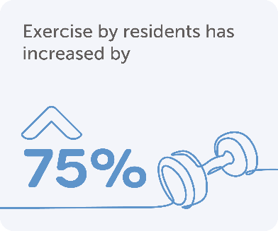
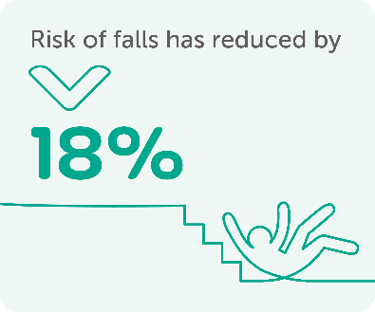
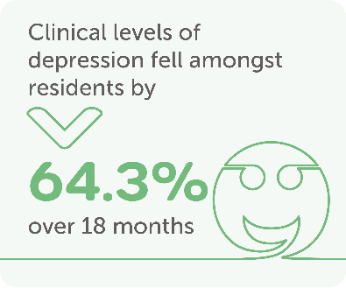
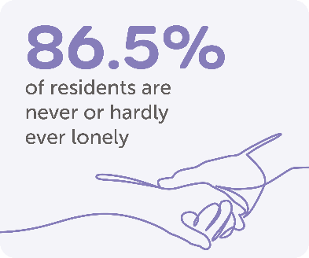
Our Impact
Data provided by Aston University (March 2019).
Sales Information | September 2026 Edition 1
8

Slide 9

Care Service
‘
My parents received such incredible care from the ExtraCare staff. They felt seen and respected, and we knew we had people we trusted their care with.
Sarah, relative of residents
Solihull Village
Solihull Village provides care for around 20% of residents living in the village. Our care staff are on-site 24 hours a day.
This includes people who are living in our community as an alternative to residential care or a nursing home, because they’re able to live independently in our community.
Residents receiving care also include people with a dementia diagnosis, where we are confident we can meet their needs and they can live safely in our community.
The care service is subject to a separate agreement and charges.
Sales Information | September 2026 Edition 1
9

Slide 10


Care Service
Our care service is tailored to support individual needs. The services that we can provide include, but are not limited to:
Cleaning
Household chores
Laundry
Assistance getting in and out of bed
Dressing
Personal hygiene and continence
Assisted bathing
Preparing meals
Assisted feeding
Medication administration assistance
Manoeuvring with hoists
Sales Information | September 2026 Edition 1
10

Slide 11

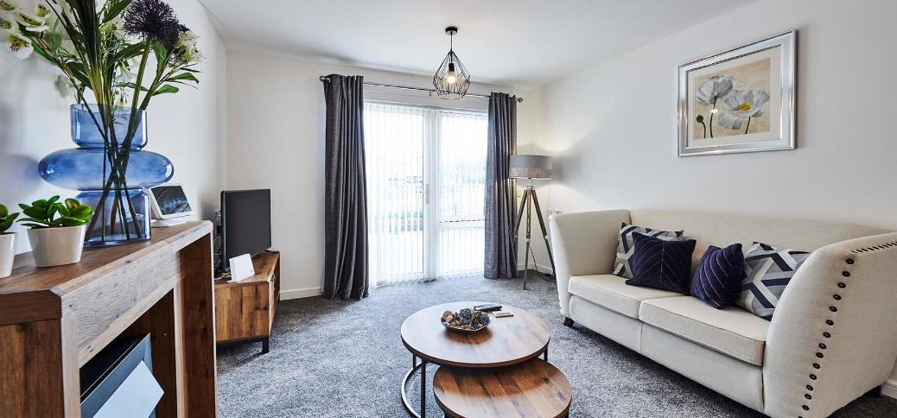
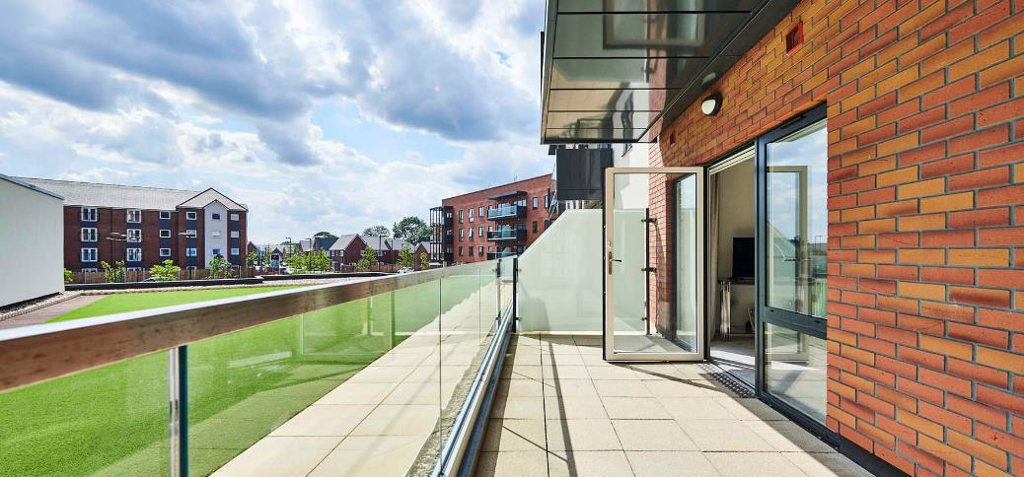
ExtraCare Homes
All our homes are designed with safety, comfort and independence in mind. Each property includes either one or two bedrooms and feature:
Integrated, high-quality kitchen appliances
Accessible shower room with anti-slip flooring
Level accessibility throughout
Sprinkler system fitted in apartments and corridors in specific villages
A private patio or balcony area, in
most apartments
Sales Information | September 2026 Edition 1
11

Slide 12
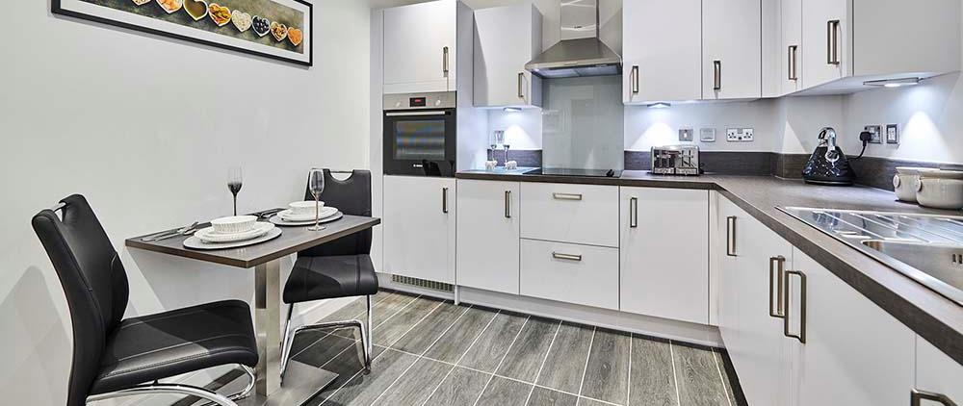
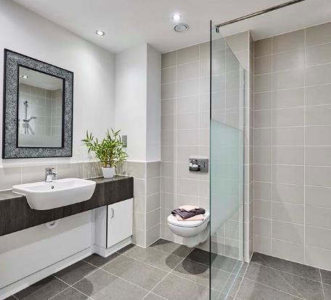

ExtraCare Homes
24 hour emergency call system
to on site staff
Closed circuit security cameras
Easy to reach switches and lights
10-year NHBC structural guarantee from September 2021
Secure entry door system connected to resident properties
Please note that apartments do not come furnished.
Sales Information | September 2026 Edition 1
12

Slide 13

Purchase Price
1 bed | Shared Ownership | From £150,000 (50%)
1 bed | Outright Ownership | £300,000
2 bed | Shared Ownership | From £180,000 (50%)
2 bed | Outright Ownership | From £360,000
Our Monthly Charge: Covers the Village Facilities Charge, Village Utilities Charge, Village Amenities Charge, and Apartment Maintenance Charge. Charges payable on leaving: Location Investment Contribution and Administration Fee. Rent is also payable on shared ownership properties at a rate of 4.5% on the unsold equity. Residents may be eligible for benefits to contribute to some of these costs. Our Key Facts documents for each tenure option provide full details of the charges and additional costs payable.
Sales Information | September 2026 Edition 1
13

Slide 14
Monthly (weekly) Charge
£835.20 (£192.74) for a one bed and £849.58 (£196.06) for a two bed apartment.
The monthly charge covers costs associated with the communal facilities and those in your own home, as detailed below:
Description | Village Utilities Charge | Apartment Maintenance Charge
Heating in your home | a
Power in your home | a
Water & sewerage services in your home | a
Wi-Fi service in your home | a
Wi-Fi service in communal areas | a
General maintenance of your home |  | a
Management of the maintenance service |  | a
Sales Information | September 2026 Edition 1
14

Slide 15
Monthly Charge
Description | Village Facilities Charge | Village Amenities Charge
Heating & lighting in communal areas | a
Cleaning communal areas | a
Gardening & landscaping | a
Building’s insurance | a
External window cleaning | a
24-hour emergency support |  | a
Welfare benefits advice & support |  | a
Please note that monthly charge is payable monthly by direct debit and is reviewed on an annual basis.
Sales Information | September 2026 Edition 1
15

Slide 16


Additional Charges
The below are not included in the monthly charges paid to ExtraCare:
Stamp duty
Council tax
Contents insurance
Telephone
Television subscriptions
TV licence
Maintenance of
white goods
Care (subject to separate agreement)
Rent (proportionate to your level of ownership)
Dementia and mental wellbeing service
Sales Information | September 2026 Edition 1
16

Slide 17


Affordable Living
Our communities are accessible to those with a range of financial means.
If you think that affordability may be an issue, we can assess your circumstances and advise the options available to you.
Our advisors can provide a free, confidential assessment to help you assess whether the village is affordable for you.
This consultation will give you a personalized breakdown of charges and information relating to possible future scenarios.
Sales Information | September 2026 Edition 1
17

Slide 18

When You Leave
The ExtraCare Charitable Trust guarantee to repay your original purchase price minus a location investment contribution (sometimes referred to as a sinking fund), a £750 admin fee and any outstanding charges (arrears) up until the point you surrender your lease.
The location investment contribution is calculated at 1% of your original purchase price per year (or part year), up to a maximum deduction of 10%. You will not benefit from any future increases in property prices or negatively affected if property prices fall.
Please note that you (or your estate) will continue to be responsible for the monthly charges up until the point that you surrender your lease back to ExtraCare.
Applies to all tenures (outright and shared ownership). It is mandatory that the property is sold back to ExtraCare. Please see the sales information pack for examples of charges when leaving an ExtraCare location.
Sales Information | September 2026 Edition 1
18

Slide 19
Applying for a Home
Please fully complete an Application for Housing and return it to your local Sales Consultant.
You must be at least 55 years old. We accept applications from all, with priority given to those with a local connection to Solihull.
We will invite you to undertake a wellbeing assessment as part of your application, so that we can assess your health and wellbeing needs, to ensure that these can be reasonably met.
A £1,000 reservation fee is required upon reservation of a property (payable by credit/debit card or a bank transfer). This will be deducted from the balance payable on completion of the purchase. If you cancel your reservation after the cooling-off period of 14 days but before exchanging contracts, we will refund the fee, subject only to the deduction of an amount to cover our reasonable costs, up to a maximum of the full amount of the fee.
Sales Information | September 2026 Edition 1
19

Slide 20

Important Information
The ExtraCare Charitable Trust is not regulated by the Financial Conduct Authority and is not authorised to give financial advice. Therefore, we strongly recommend that before making any decision based on the information provided in writing, electronically or verbally, that you consult with a specialist adviser or take independent legal and financial advice.
You can also seek independent advice from the Citizens Advice Bureau www.citizensadvice.org.uk.
We would encourage you to discuss the implications of moving to an ExtraCare community with your family and friends.
These particulars are set out as a general outline for guidance only. The information in this presentation does not in any way form part of a contract or warranty.
If any of this information is unclear or for any further questions, please contact your local Sales Consultant.
Sales Information | September 2026 Edition 1
20

Slide 21

Contact Us
Glenny Helina Neeson
Village Sales Consultant
07989 441261
glenny.helina@extracare.org.uk
Sales Information | September 2026 Edition 1

